Slide 1



Deciphering LLC charge mode controller implementation (NCP4390) and mixed-mode modelling using Qspice
Vietnam Power Electronic Community – Webinar(2024/04/27)
Arief Noor Rahman
Senior Power Electronic Engineer
––––––––– FSP Technology –––––––––
https://www.linkedin.com/in/arief-noor-rahman-3880a536
https://forum.qorvo.com/u/physicboy/summary
https://github.com/physicboy/QSPICE

Slide 2
Disclaimer
I am working for FSP-Technology and not affiliated to Onsemi or Qspice/Qorvo.
NCP4390 is a charge mode controller IC developed and manufactured by Onsemi. Currently, this IC is used in one of our design, and this presentation only presents the method I used to understand and built model of the IC in simulation.
Qspice is a Spice variants developed by Mike Engelhardt and teams at Marcus Aurelius Software LLC solely for Qorvo. This software is freely available from Qorvo website.
Materials presented contain no confidential information that belong to my past and current employer.

Slide 3
Introduction
Direct frequency modulation vs Charge mode control
Direct frequency modulation (L6599 or UCC25600)
Charge mode control (NCP4390, UCC25660, UCC2564xx, HR1211, TEA9026, TEA2016/7)
The need for modelling and simulation
Prototyping and hardware testing are time and cost intensive
Simulation helps to get closer to desirable result faster and cheaper
How to create a moderate complexity yet accurate IC model for simulation?
What and why Qspice?
Free
Support C and Verilog modeling
Crazy fast

Slide 4
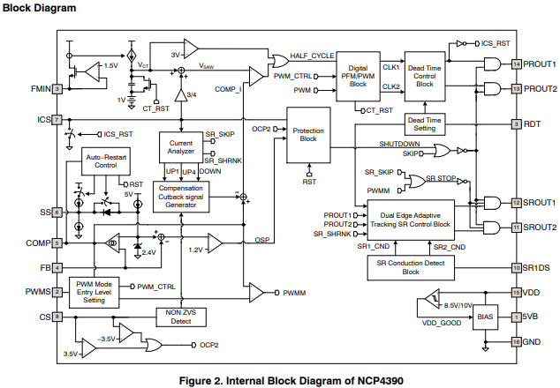
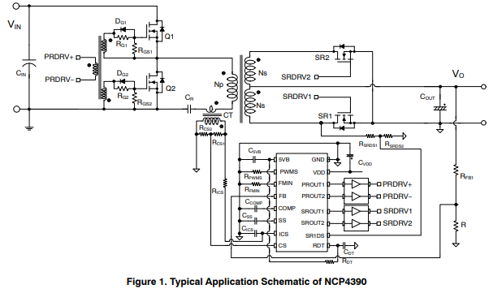
NCP4390 General Overview
Note:
NCP4390 is implemented in mixed-mode fashion. Compensation, soft start, slope compensation, and charge mode control is implemented using analog comparator/OPA/OTA
The rest of the circuits is implemented using digital approach.

Slide 5
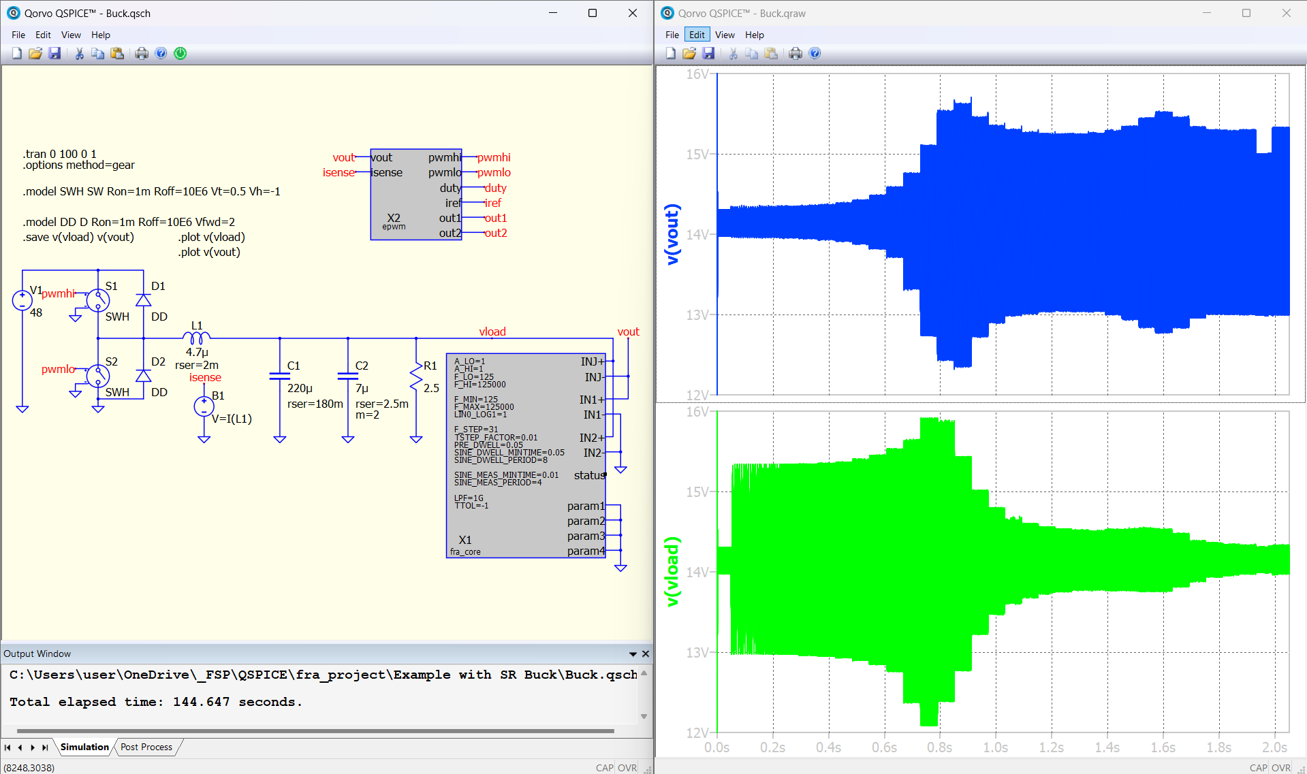

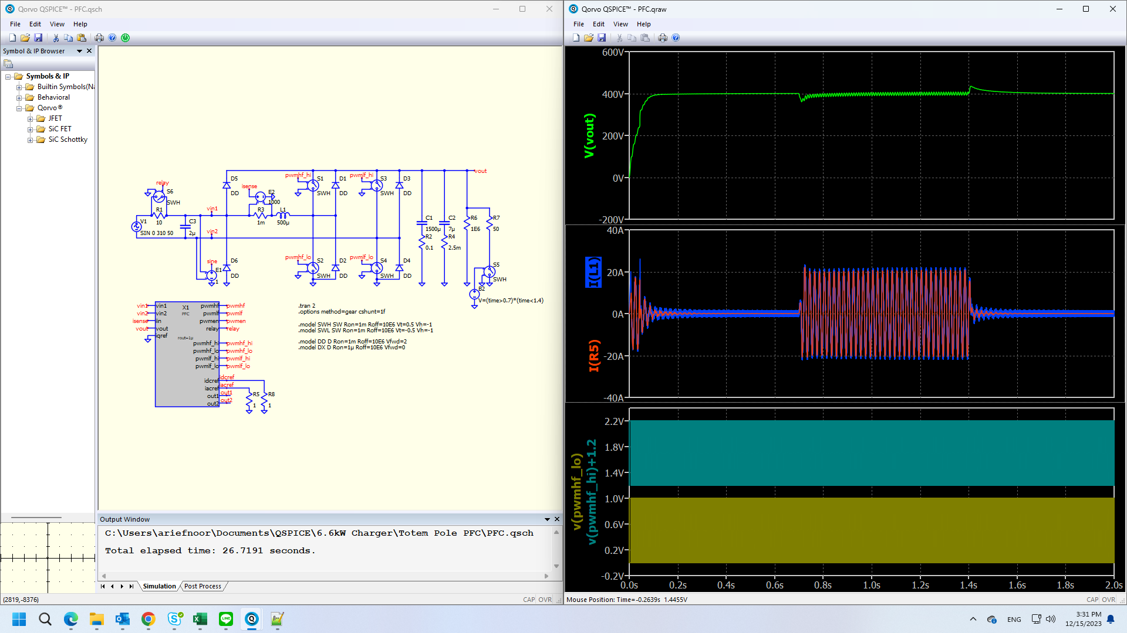
Hey Qspice!
Developed by Mike Engelhardt
For Qorvo
Primary features:
1. Free
2. The only spice with native ideal switch model
3. Native capability for instant discontinuity handling
4. Mixed mode simulation with C-block or Verilog support
5. Natively fast
6. Insanely fast, with C block timing control

Slide 6
Modelling Approach
Be clear about the goal: Controller performance evaluation
Identify the critical IC functions towards the modelling goal:
Compensator,
Soft start,
Charge mode control implementation,
Voltage controlled oscillator,
Burst mode,
Not required: advanced protection, low power operation mode, SR controller,
Start simple
Evaluate each functions independently
Combine all functions and test.

Slide 7
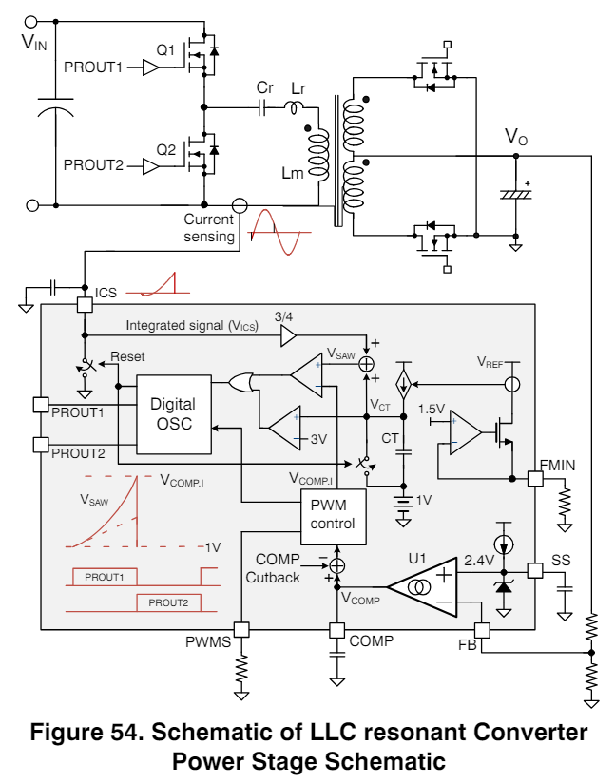
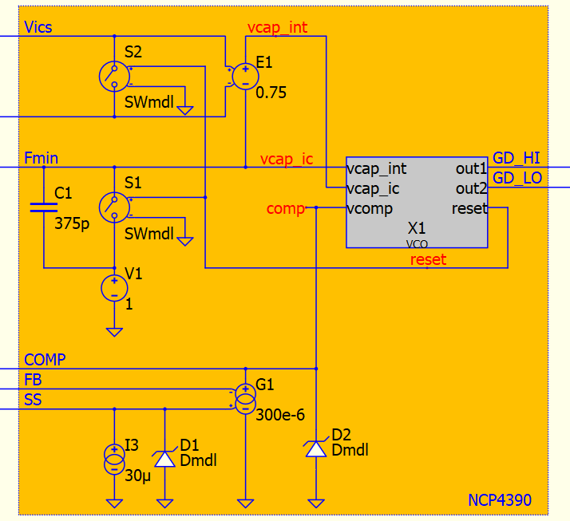

Controller Overall
https://github.com/physicboy/QSPICE/tree/main/NCP4390%20-%20VPEC

Slide 8
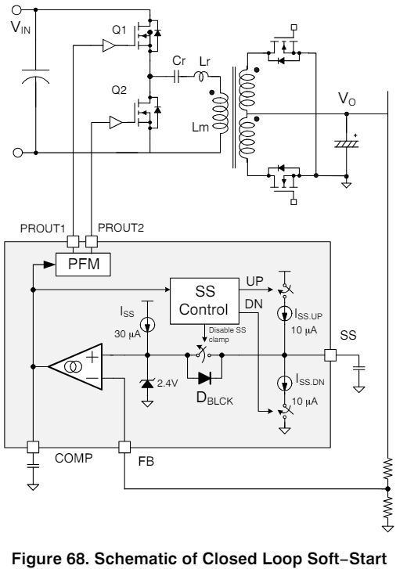
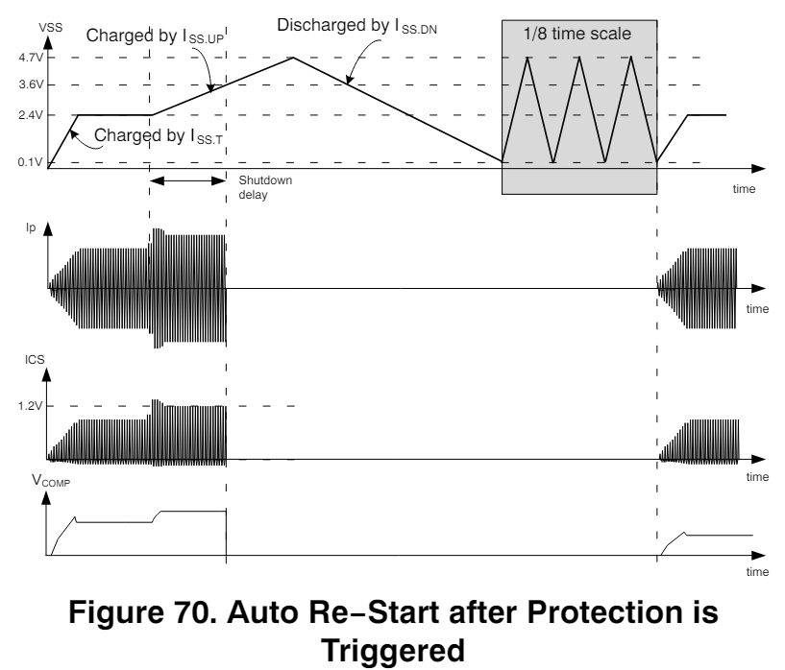
Compensation and Soft Start
2.4V
5V

Slide 9
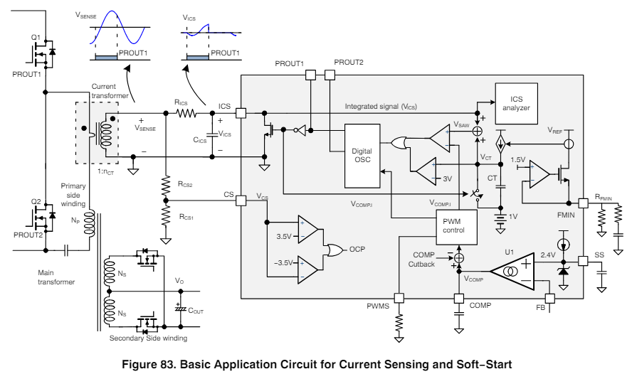
Charge Mode Controller Implementation
Resonant charge estimator
Charge mode controller
Internal slope generation
Minimum frequency implementation
0.75

Slide 10
VCO and Burst-mode Implementation
Initial information from datasheet face value:
it sense the internal slope to force minimum switching frequency by comparing with 3V
it measure the Vcomp
it senses the sum of charge and internal slope and compare it with Vcomp to turn off the Main power switch
Vcomp < 1.25V enter skip cycle (burst mode) Vcomp > 1.3V normal operation
Some of the deduced information:
VCO is digital asic with 40MHz clock
Output PWM signal is sync’d to 40MHz clock
Charge mode operation occurs only on half of the switching period (when upper MOSFET is on.
The lower MOSFET on-duration is mirror of the upper MOSFET. Implemented using up-down counter.
reset signal is generated based as an exact inverse of upper MOSFET signal. When device enter burst mode, reset signal is held active.
Deadtime setting is directly taken from datasheet

Slide 11
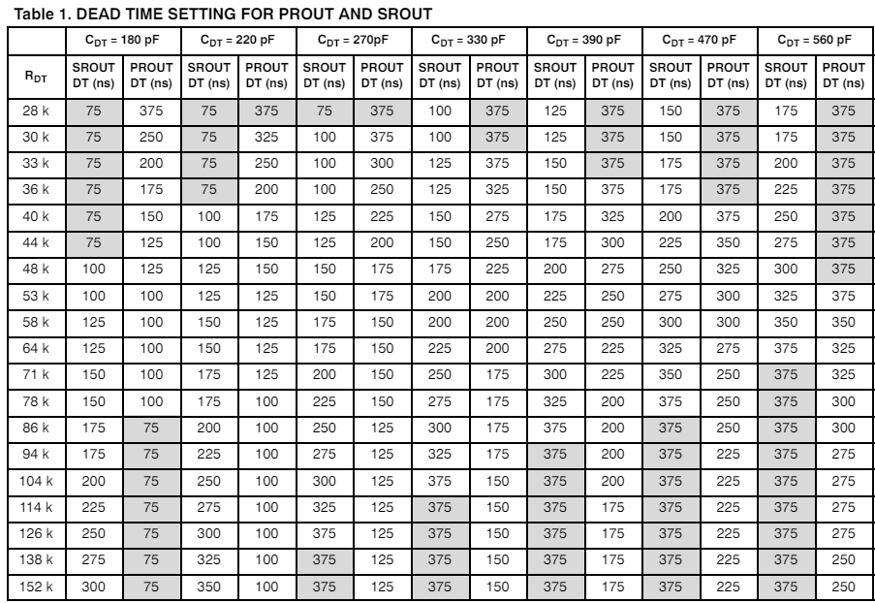
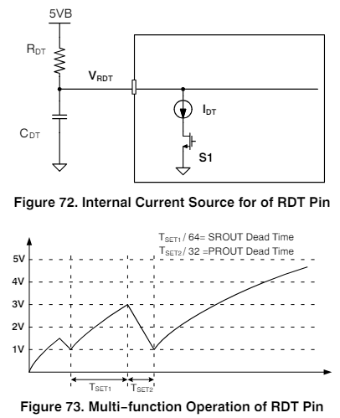
Dead-time Implementation
Practical Note:
Secondary side deadtime should be greater than primary side deadtime
In simulation, this

Slide 12
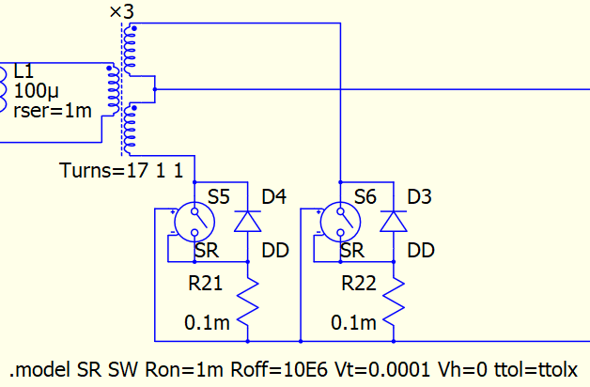
Simplified SR Implementation

Slide 13
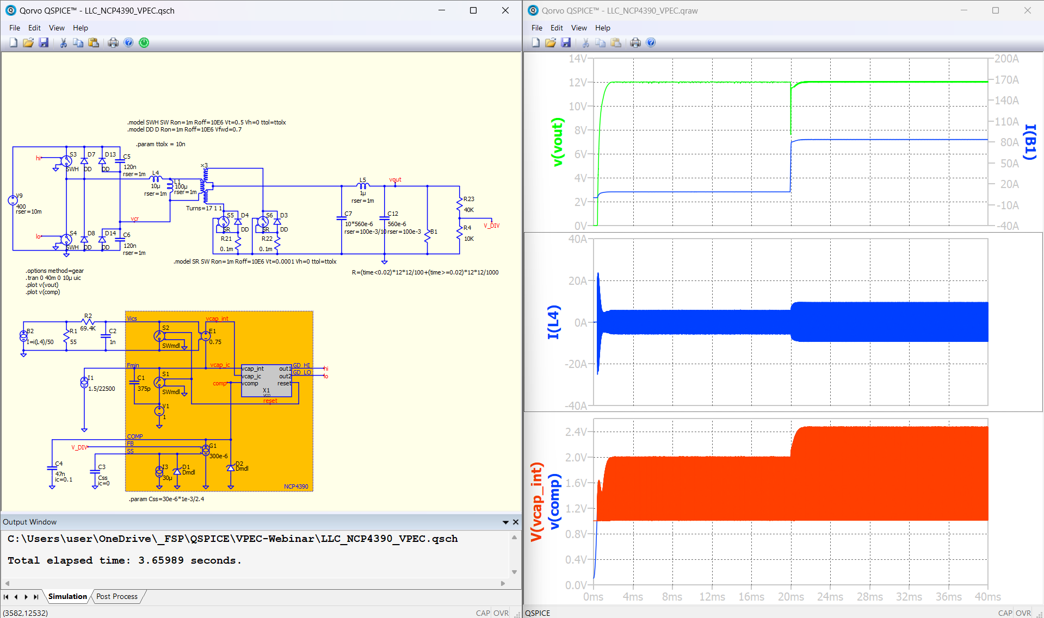
Transient simulation result

Slide 14
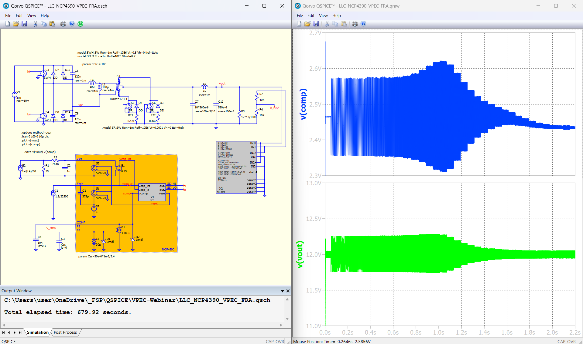
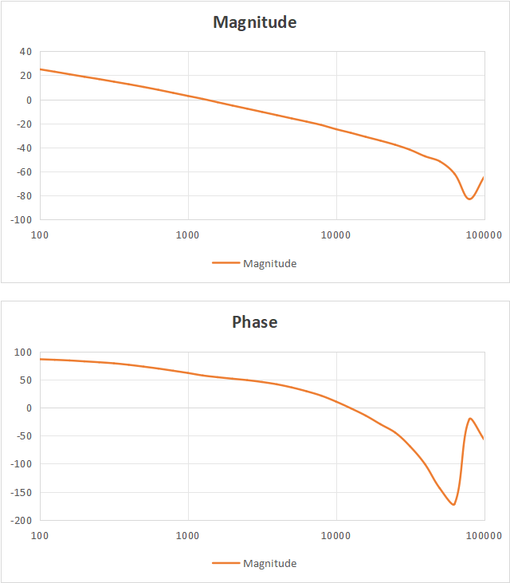
Frequency Response Analysis simulation result

